Slide 1

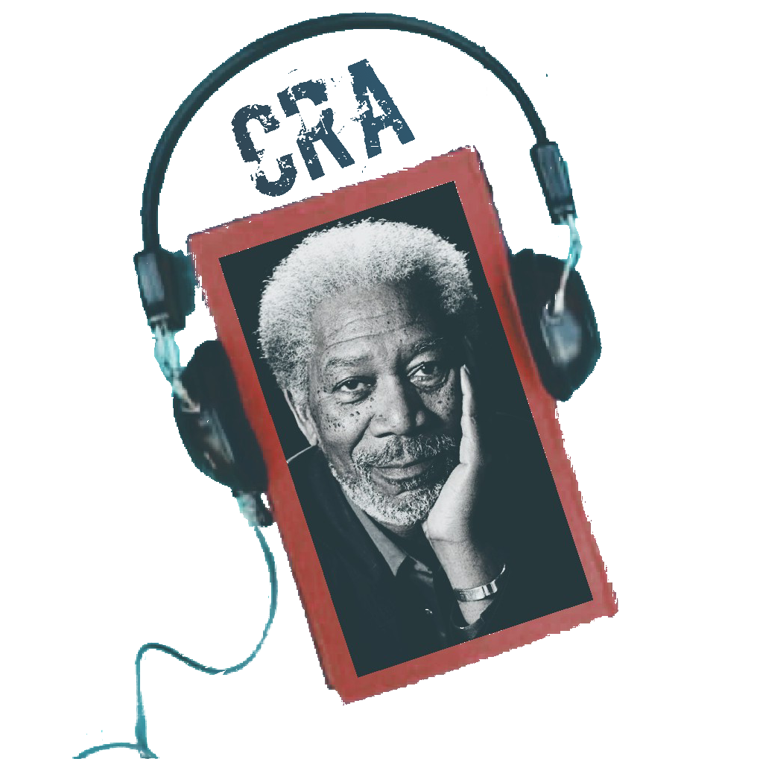
26th February 2020

Slide 2
Boring ha?!

Slide 3
Robotic VOICE?!

Slide 4
26th February 2020
Celebritized Reader for audiobooks

Slide 5

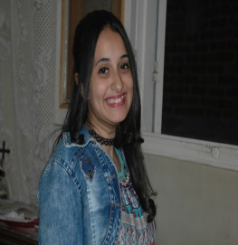
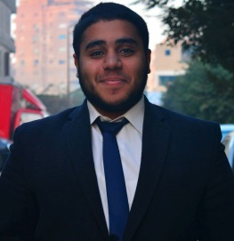
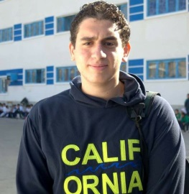
Our team
Dalia Mohamed
Mary Nader
Mahmoud Youssri
Mohamed Abdelaziz
Prof.
Khaled
Soradi

Slide 6
Agenda
Product
Challenges
System
Architecture
Competitors
Tools
Time plan
Future works

Slide 7
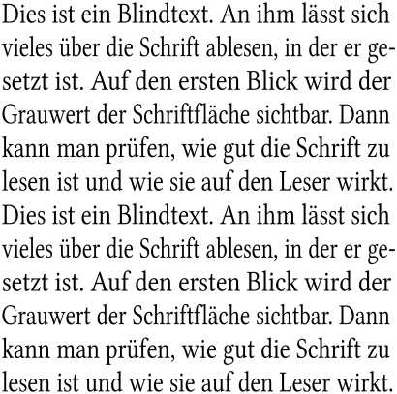

Our Idea

Slide 8

Our Product

Slide 9

Our Product

Slide 10
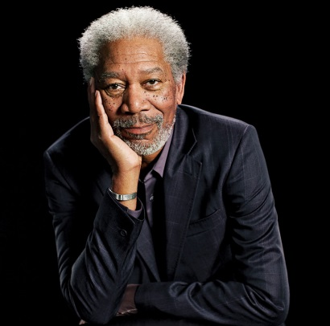
Our Product

Slide 11
Challenges

Slide 12
Challenges
Robotic
Voice

Slide 13
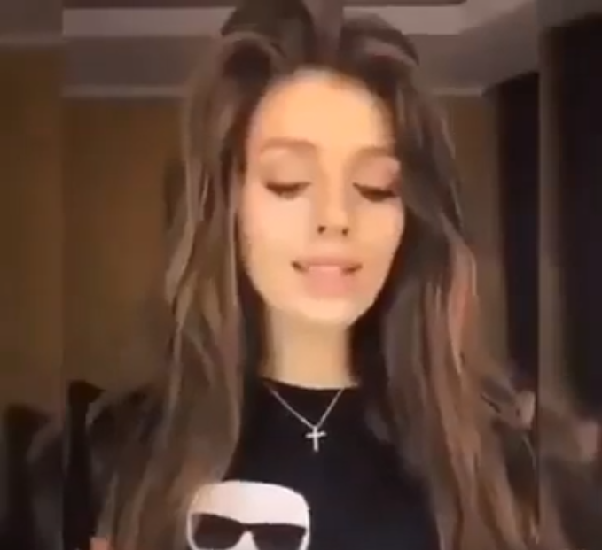
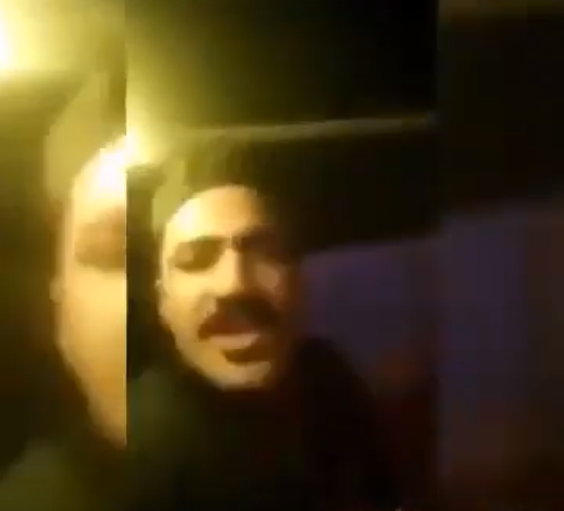
Challenges
Fading
Out
Robotic
Voice

Slide 14
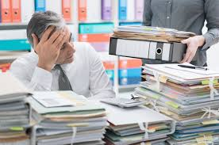
Challenges
Data
Set
Robotic
Voice
Fading
Out

Slide 15
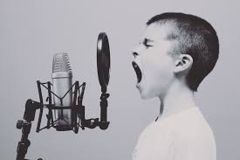
Challenges
Voice
Styling
Robotic
Voice
Fading
Out
Dataset

Slide 16

Challenges
Performance
Robotic
Voice
Fading
Out
Dataset
Voice
Styling

Slide 17

Challenges
Robotic
Voice
Fading
Out
Dataset
Voice Styling
Performance

Slide 18
System Architecture

Slide 19
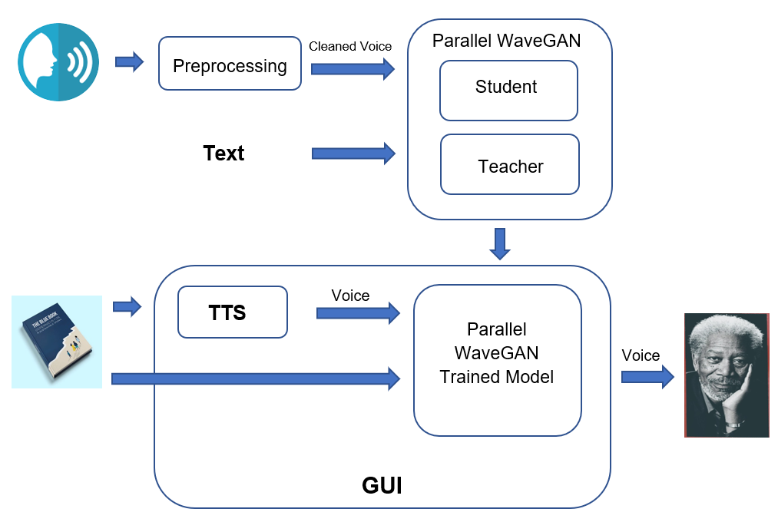
System architecture

Slide 20
List of Deliverables

Slide 21
Deliverables
Modules | Input | Output | Used Tools
Preprocessing | Actual Voice | Cleaned Voice | Librosa
Parallel WaveGAN | Text, Cleaned Voice | Trained Model | Pytorch
TTS | Text Book | Voice | None
Trained Model | Text, Voice generated from TTS | Celebrity’s Voice | None
GUI Mobile App | Text Book | Celebrity’s Voice | Android Studio

Slide 22
Competitors

Slide 23





competitors
Google
Librera
Amazon Audible
Voicer
LibriVox

Slide 24
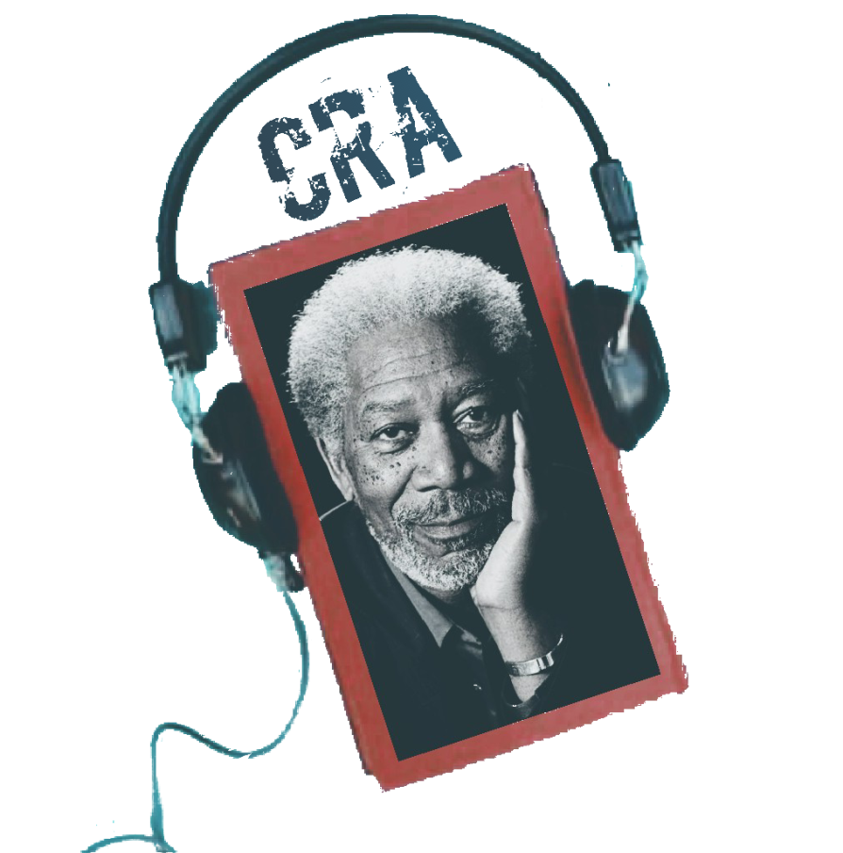

Domination Example
They show that there are indeed substantial and signiﬁcant
diﬀerences in the numbers of base word types.

Slide 25
Tools

Slide 26






tools

Slide 27
Time plan

Slide 28
Time plan
July-Oct
Idea Generation
Dec-Jan Finals
26th Feb Seminar
June-July Finals
Oct-Dec Research & Design
Jan-Feb Proof of concept
Feb-June Implementation & Integration
July Optimization & Documentation

Slide 29
Future Work

Slide 30
Future work
Environment Effects
Reader
Face
Imitation

Slide 31
Thank you!

Slide 32
Any questions?!

